Slide 1


Slide 2
Examples’ Source Code
Source Code for examples presented in these slides can be found on:
Blackboard->Course Content->Source Code Of The Book Examples

Slide 3
Documenting Methods
A method should always be documented by writing comments that appear just before the method’s definition.
The comments should provide a brief explanation of the method’s purpose.
The documentation comments begin with /** and end with */ (javadoc).

Slide 4
Commenting the Public Interface - Javadoc
comes with Java JDK
automatically generate documentation for the classes, interfaces, and methods
produces HTML documentation with the same structure as the Java API documentation.
To generate this documentation, there are two general steps necessary:
Write documentation comments in the Java source code file
Run the javadoc utility

Slide 5
Commenting the Public Interface - Javadoc
Provide documentation comments for
every class
every method
every parameter
every return value
Javadoc tags
@author AuthorName class
@version VersionNumber class
@param parameterName Description method
@return Description method

Slide 6
@param Tag in Documentation Comments
You can provide a description of each parameter in your documentation comments by using the @param tag.
General format
@param parameterName Description
All @param tags in a method’s documentation comment must appear after the general description.The description can span several lines.

Slide 7
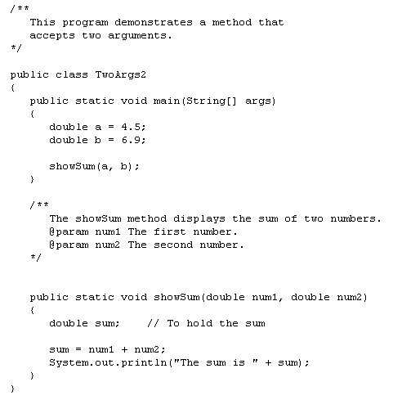
Method documentation comes
before method definition
@param tags must appear after the general description.

Slide 8
@return Tag in Documentation Comments
You can provide a description of the return value in your documentation comments by using the @return tag.
General format
@return Description
The @return tag in a method’s documentation comment must appear after the general description. The description can span several lines.

Slide 9
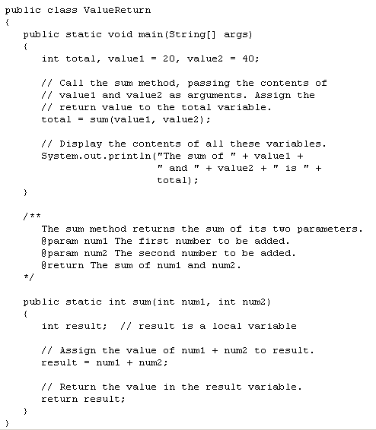

Slide 10
Commenting the Public Interface - Javadoc
Class Comment
/**
A bank account has a balance that can be
changed by deposits and withdrawals.
@author Professor Myers
@version 1
*/
public class BankAccount
{
. . .
}

Slide 11
/**
A bank account has a balance that can be changed by
deposits and withdrawals.
@author Professor Myers
*/
public class BankAccount {
/** the balance of the Bank Account
*/
private int balance;
// Constructors
/** Constructs a Bank Account with balance set to 0
*/
public BankAccount()
{
// body--filled in later
}
/** Constructs a Bank Account with the balance set to initialBalance
* @param initialBalance
*/
public BankAccount(double initialBalance)
{
// body--filled in later
}
/** Withdraws money from the bank account.
@param amount the amount to withdraw
*/
public void withdraw(double amount)
{
//implementation filled in later
}
/** Gets the current balance of the bank account.
@return the current balance
*/
public double getBalance()
{
//implementation filled in later
return 0.0;
}
/** sets balance to 0
*/
public void reset()
{
//implementation filled in later
}
}
Javadoc tags
Javadoc comments

Slide 12
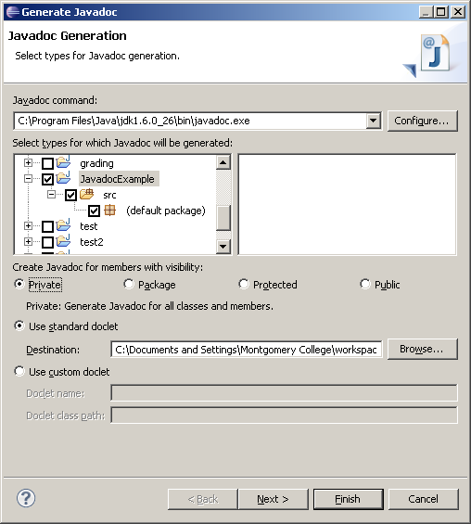
Generating Javadoc in Eclipse
Find where the javadoc.exe
exists on your computer. It
will be in the bin folder of
your jdk. Put the pathname
here.
1. Under Project, Select “Generate Javadoc”
Select the project you want
to generate the javadoc for
Select private so that private
fields will show up in
documentation
Choose the folder where the javadoc will be stored
Use the standard doclet
Select Finish

Slide 13
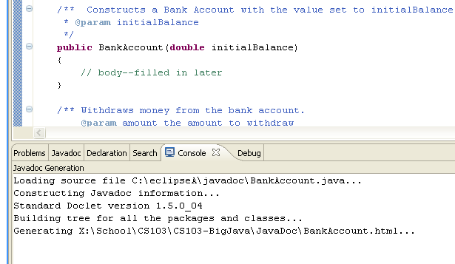
Generating Javadoc in Eclipse
In the Console window you will
see the javadoc files being
generated

Slide 14
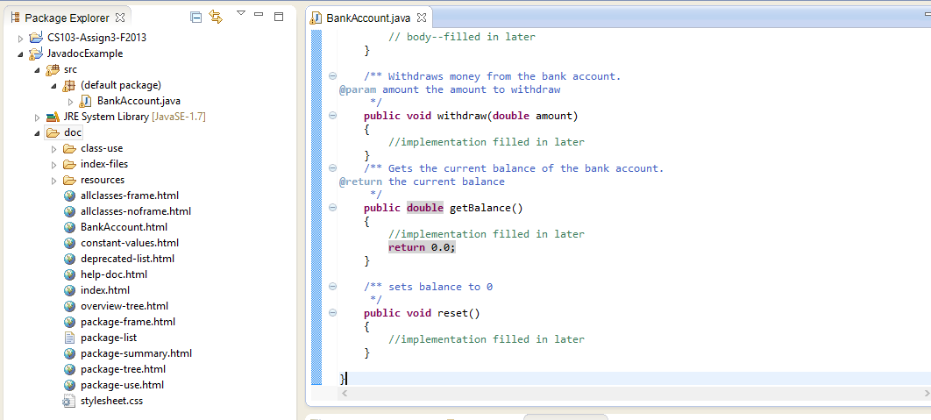
Open the doc folder
Select index.html

Slide 15
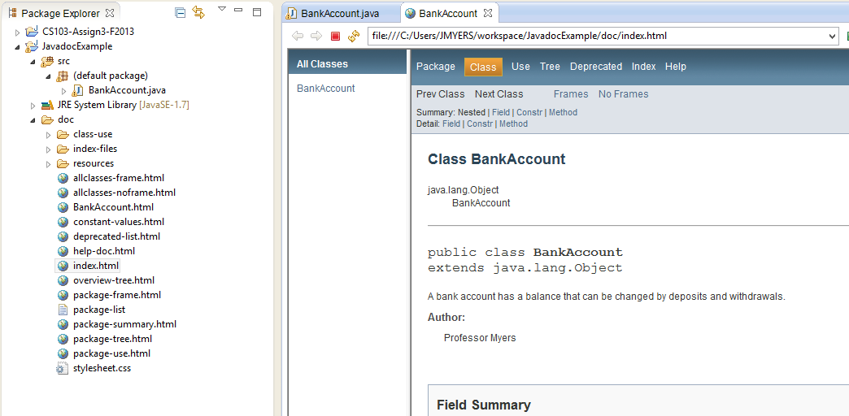
List all the classes in the project on left

Slide 16
You can also right click on index.html and
Open with -> Other

Slide 17
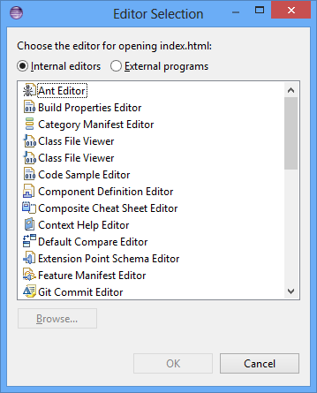
Select External programs

Slide 18
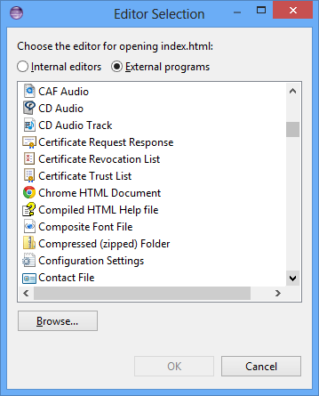
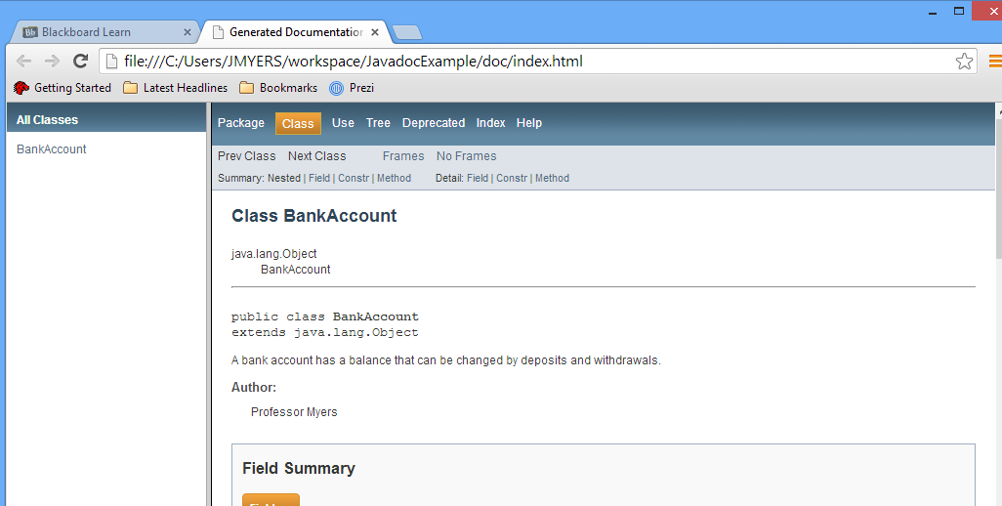
Select your browser to have display
outside of Eclipse in a browser

Slide 19
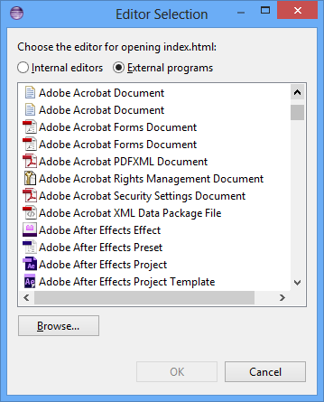
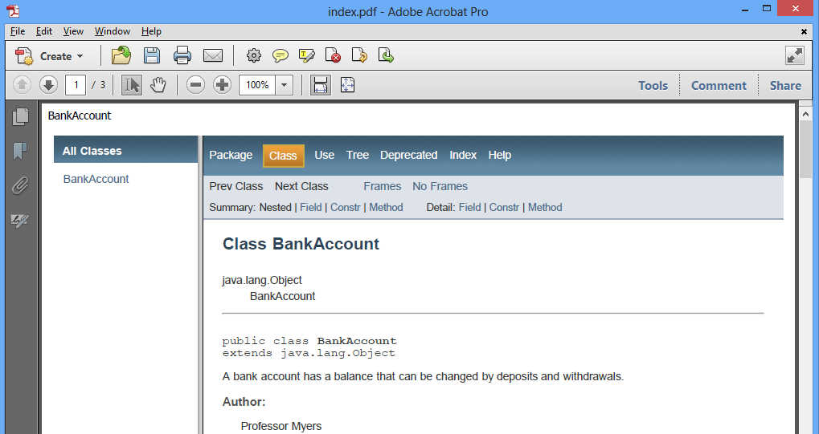
Select Adobe Acrobat Forms Document
to display it as a .pdf file that can be
saved

Slide 20
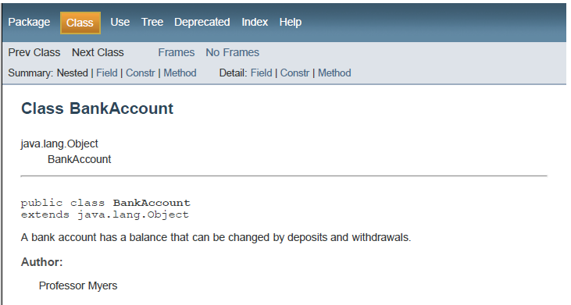
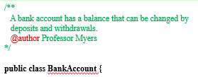
Parts of the Javadoc Document

Slide 21
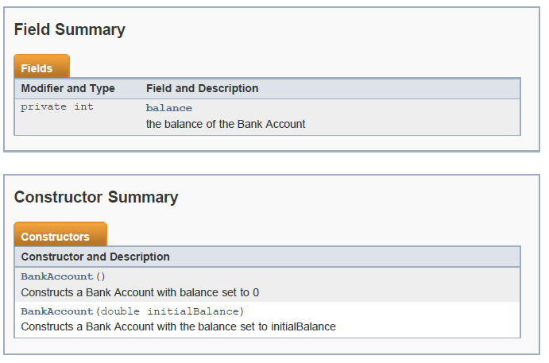
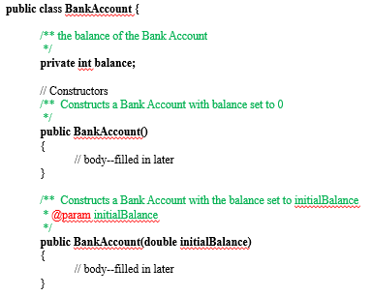

Slide 22
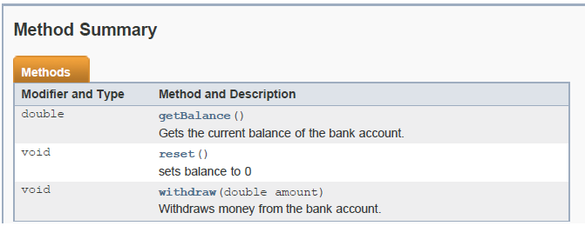
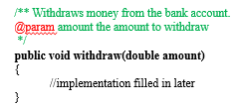
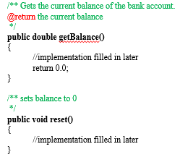

Slide 23
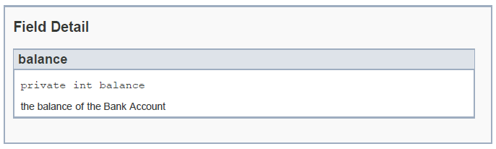
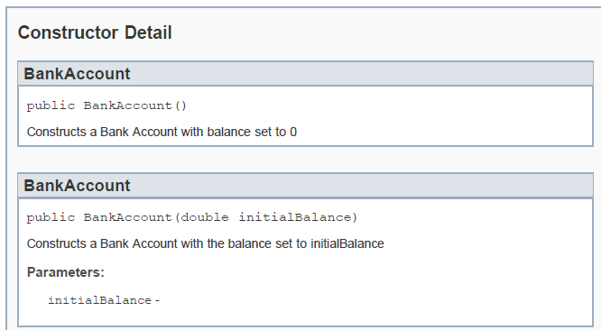

Slide 24
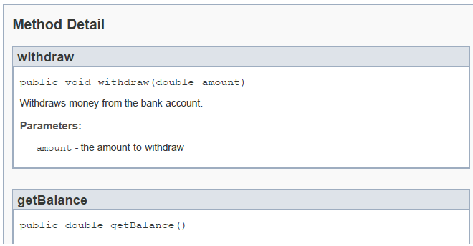
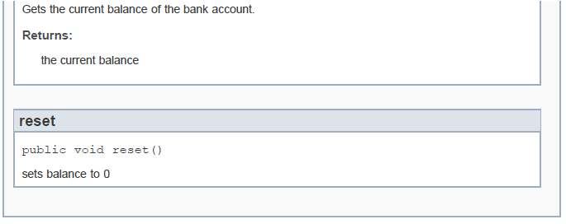

Slide 25
Notice no description for initialBalance
/** Constructs a Bank Account with the balance set to initialBalance
* @param initialBalance
*/
public BankAccount(double initialBalance)
{
// body--filled in later
}

Slide 26
Notice there is a description for amount
/** Withdraws money from the bank account.
@param amount the amount to withdraw
*/
public void withdraw(double amount)
{
//implementation filled in later
}

